Slide 1
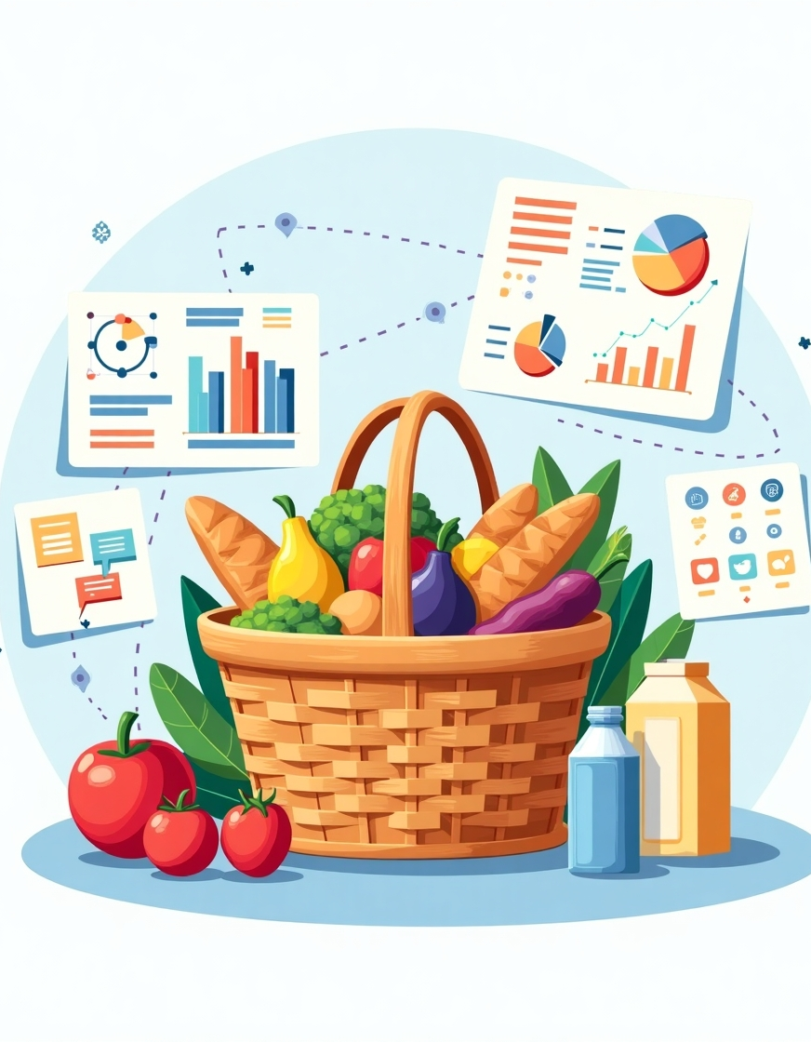
Marketing and Retail analytics
Kunal Sarkar

Slide 2
Market Basket Analysis
Introduction
EDA, understanding the data
Goal setting
Understanding the necessity
Understanding the analysis
Algorithms used and logic used to set the parameters.
Recommendations
Recommendations based on statistical deep diving
Summary
Recommendations based seasonal impact.

Slide 3
Areas of focus
Understanding the data
Understanding the Data provided(Unique items, nulls if any, duplicates)
Capitalize on the data by illustrations
Visualize the historical Data to design the algorithm for accurate predictions
Statistical implications
Understanding the purchase behavior through statistical deep diving
Recommendations

Slide 4

Introduction
Marketing and Retail Analytics strategically deconstructs the intricate dimensions influencing consumer purchasing behavior, aiming to segment customers, transactions, and products with precision—ultimately driving data-driven business growth and competitive advantage

Slide 5
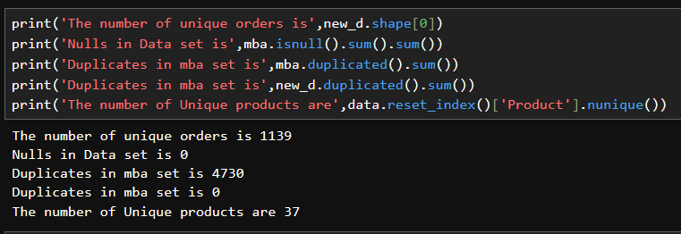
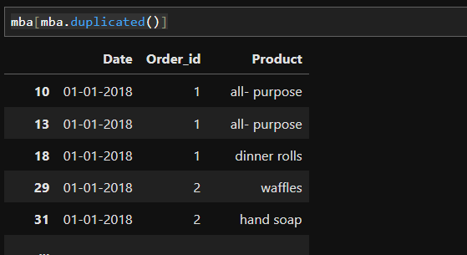
Exploratory Data Analysis
We have used Python to find the number of duplicates, Null values and no of actual orders based on order id.
Code 1 : ‘new_d.shape[0]’ Here new_d is the newly formed data frame where the actual data frame named ‘mba’ is used, the order number is used to group the data into rows with the ordered items concatenated. This code resulted in a set of rows where each row represented one order id with all the products ordered in against an individual order_id.
Findings, total number of orders =1139,
Code 2 : nulls = Nil.
Code 3&4: ‘mba.duplicated().sum()’ VRS ‘new_d.duplicated().sum()’: This code represents the number of duplicates in the dataset mba of which was found to be 4730, this finding was obvious as there were multiple orders with duplicate dates or orders placed on the same date etc. This was in order when we used the new_d and found zero duplicates
Code5: ‘mba.isnull().sum().sum()’ : This code calculates the total number of unique products. No of unique items =37

Slide 6
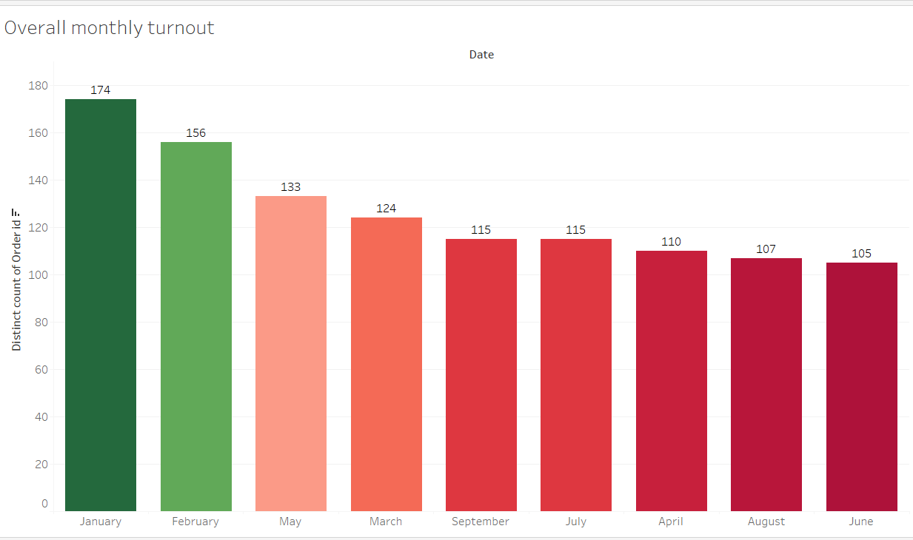
Exploring the Monthly sales pattern
The chart has been extracted from Tableau. The Bar plot illustrates the overall average sales for every month. Where color green represents the peak and dark red represents the drop of average sales turnout.
January clocks the highest sales followed by February on the other hand April, June, July, August and September are the months with poor performance

Slide 7
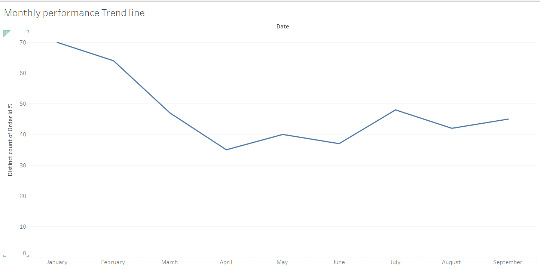
Exploring the monthly sales trend line
We can ideate the seasonality from the monthly sales trendline.
January emerges as a clear peak month, driven by festive fervor and heightened consumer spending during the holiday season.
This momentum tapers off in February, reflecting a natural post-festival slowdown, as consumers return to regular consumption habits.
A renewed surge appears in May, likely fueled by summer vacations and increased discretionary spending.
Post-September, the trend line begins to ascend once more, marking the onset of the high-demand festive quarter, culminating in the December-January celebration cycle that drives retail activity to its apex.

Slide 8
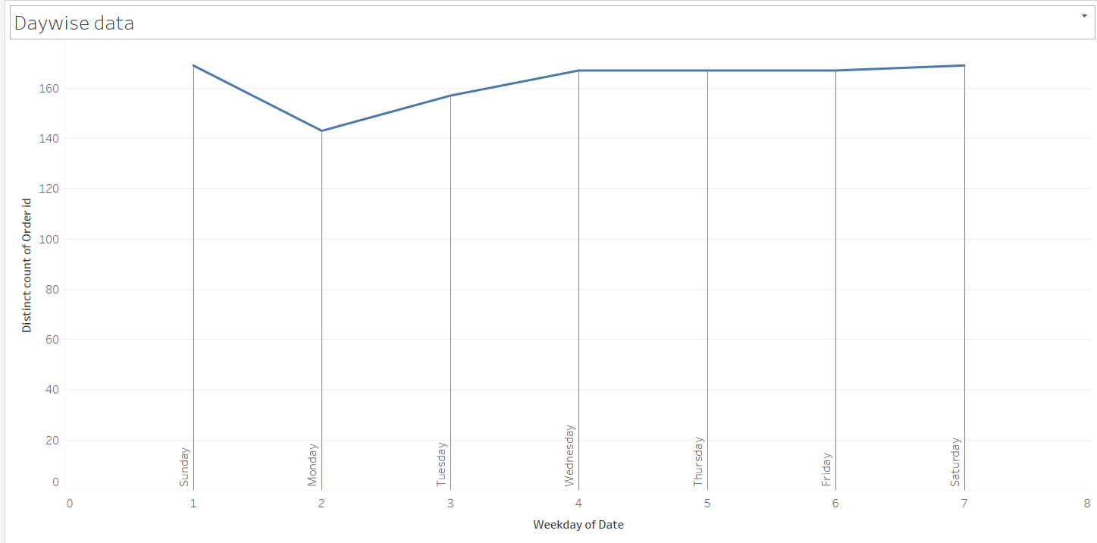
Exploring the Day wise sales pattern
The Day wise sales pattern shows how sales have spiked on Sundays and suddenly dropped on Monday indicating that Mondays are that day of the week when customers order the least

Slide 9
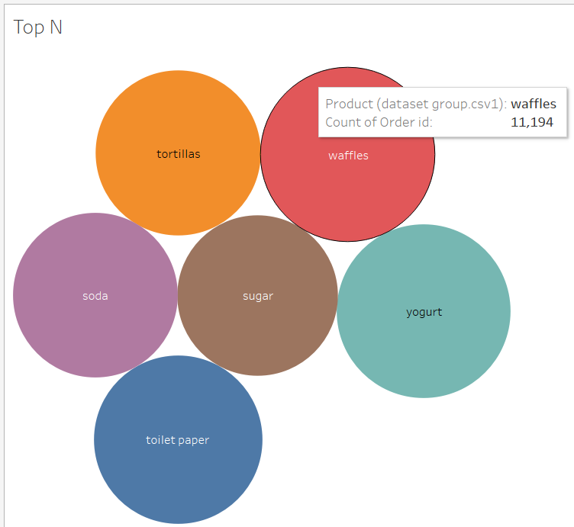
Top & bottom 6 most sold
The Bar plot illustrates the Top 6 most sold items which are waffles, yogurt, toilet paper, tortilla, soda, sugar.
Theses Items are the most ordered products.
Here Red denotes highest and light yellow represents the least. Here filters used were Top – Bottom-N

Slide 10
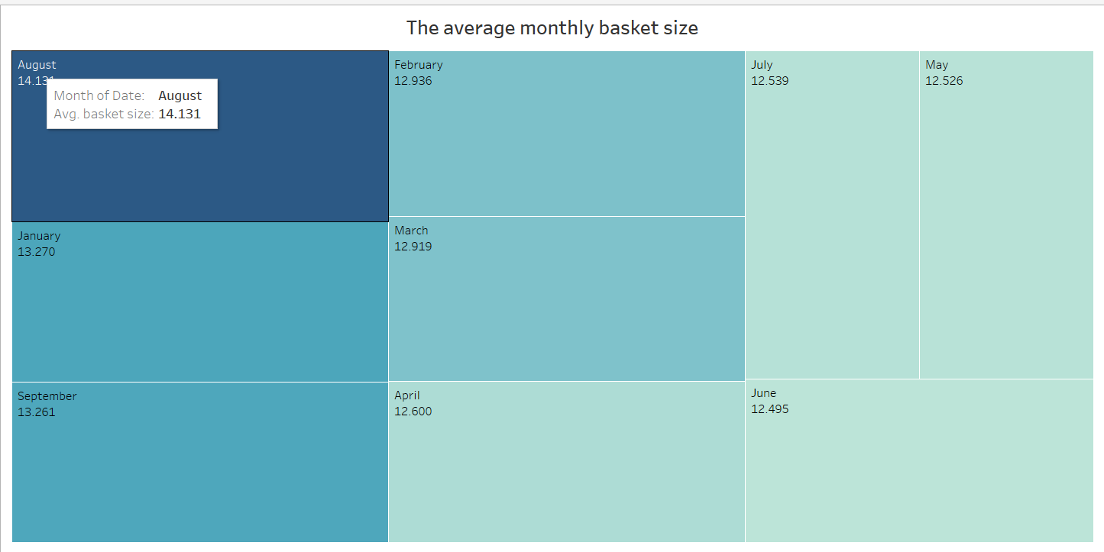
Average monthly basket size
The Average monthly basket size denotes the no of items customers choose; this data however is aggregated on the entire date.
The Month with the highest average is August followed by January.

Slide 11
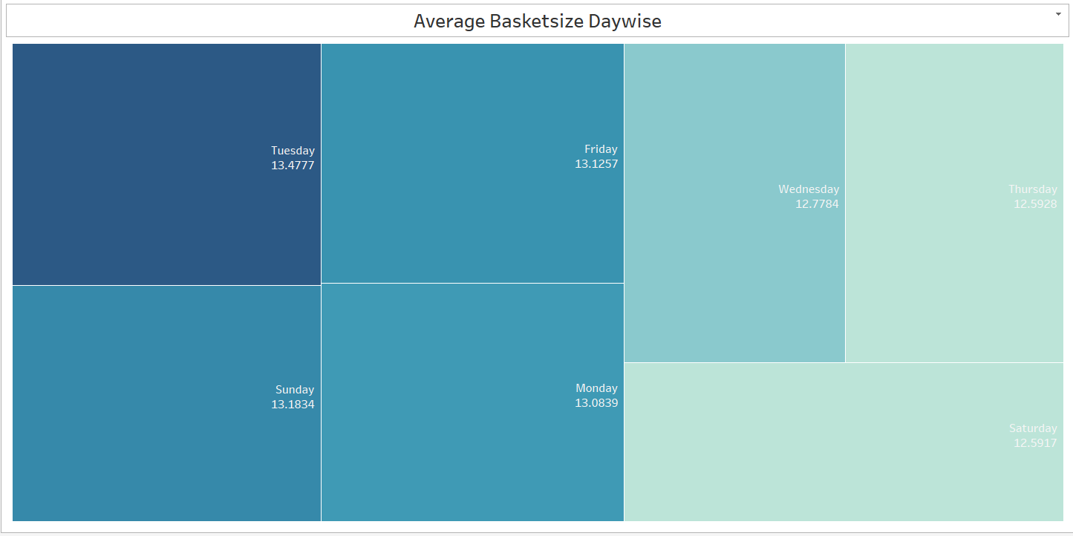
Average basket size by day
The Average Day-wise basket size denotes the no of items customers choose to buy on a given day of the week.
Tuesday the weekend tops the chart.

Slide 12
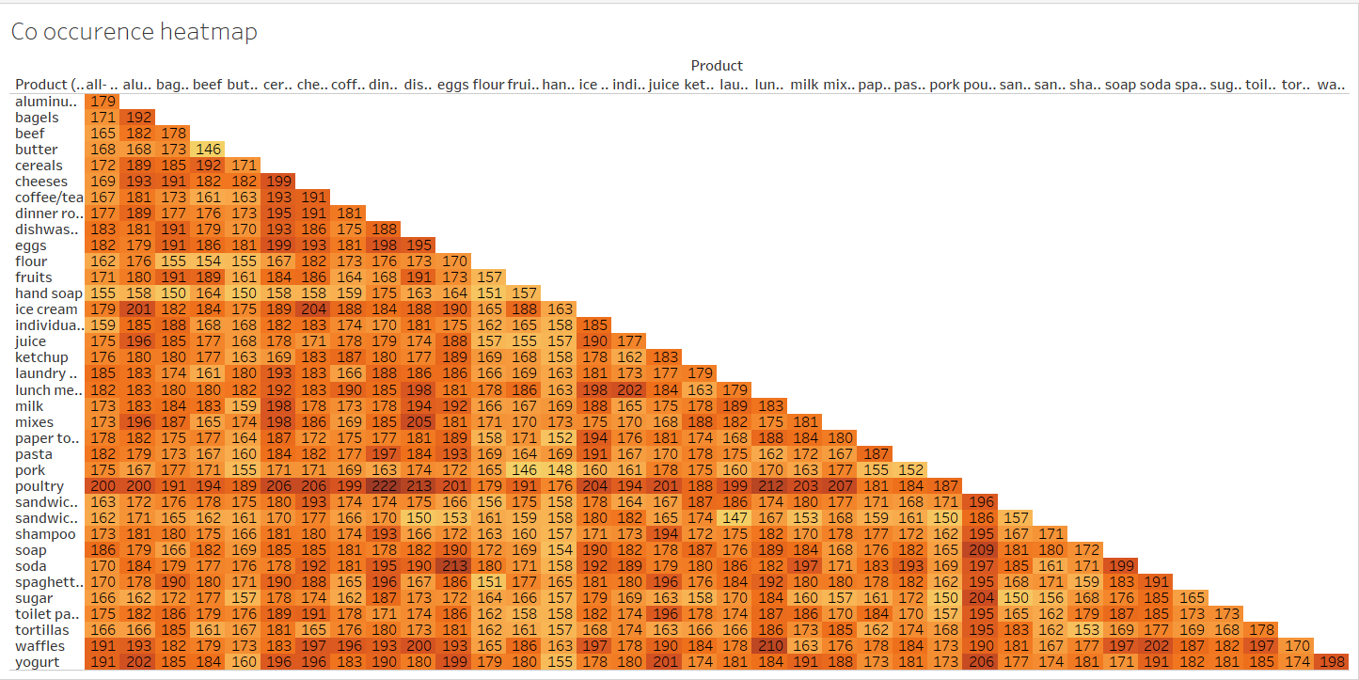

Slide 13
The Cooccurrence Heatmap
The Heatmap denotes the cooccurrence of given product a with product b.
The Purpose of plotting the co occurrence heatmap is to illustrate which of the 2 items of all the unique items appear the most with each other. In retail perspective this can be understood as preference of a product y every time a customer purchases product x. Identifying these products can help structure the recommendation system which will prompt the seller with the help of historical data the items which the customer is most likely to purchase in association with the existing products in his present basket. By leveraging this strategic brilliance, sellers can skillfully expand basket size, transforming the customer journey into an enriched and lucrative experience.
Observation from the existing data Poultry and Dinner towels, Poultry and dishwashing Liquid

Slide 14
Brief Summary of the EDA
The Most high performing months are January and February
There is seasonality in the data with 2 major spikes –October which is likely till January and May.
Top 6 most sold items are Poultry, Ice-cream, Cereals, Lunch meat ,cheese eggs.
Monday is that day of the week on which customers are least interested to shop.
Observation from the existing data shows Poultry with Dinner towels, Poultry with dishwashing Liquid and poultry with Lunch meat are most shopped together items.

Slide 15

Primary goal
Identify the most frequently co-purchased item sets to generate intelligent product recommendations and craft strategic bundle offers that significantly amplify sales.

Slide 16

Introduction to the algorithm used
We have used Association Rule mining algorithm in Knime workflow in order to develop an understanding of the association of the products frequently ordered in association with other products from the available retail data.

Slide 17
Association Rules
The aim of the study was to find the most occurring combinations and provide recommendations to push sales, indicates item groups with the highest commonality or customer preferences which in analytics stands for a higher confidence and lift this could only be achieved if we had tested through the maximum no of combinations having the most customer likeability. The best combination achieved when support =0.02 & confidence=0.75(confidence more than 75%)
Support | Confidence | Lift | Max Support reached | Max Confidence Reached | Max Lift Reached | Rules /combinations
0.09 | NA | NA | 0.421 | NA | NA | 715
0.09 | 0.5 | NA | 0.195 | 0.579 | 1.49 | 31
0.025 | NA | NA | 0.421 | NA | NA | 66080
0.025 | 0.5 | NA | 0.195 | 0.857 | 2.194 | 59829
0.02 | NA | NA | 0.421 | NA | NA | 96532
0.02 | 0.75 | NA | 0.032 | 0.885 | 2.349 | 480

Slide 18
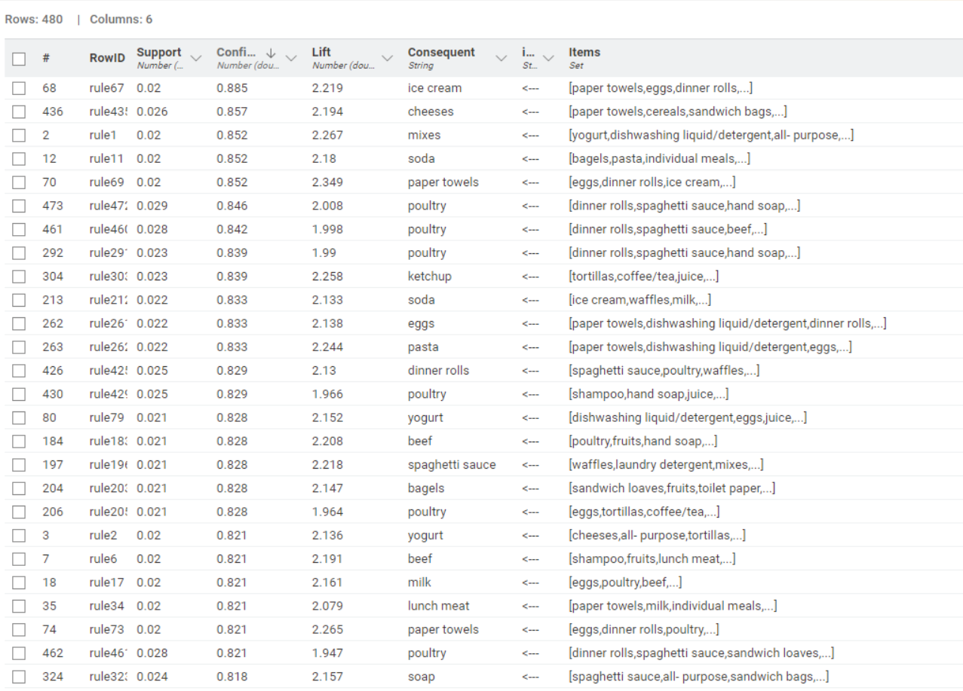
Association Rules

Slide 19
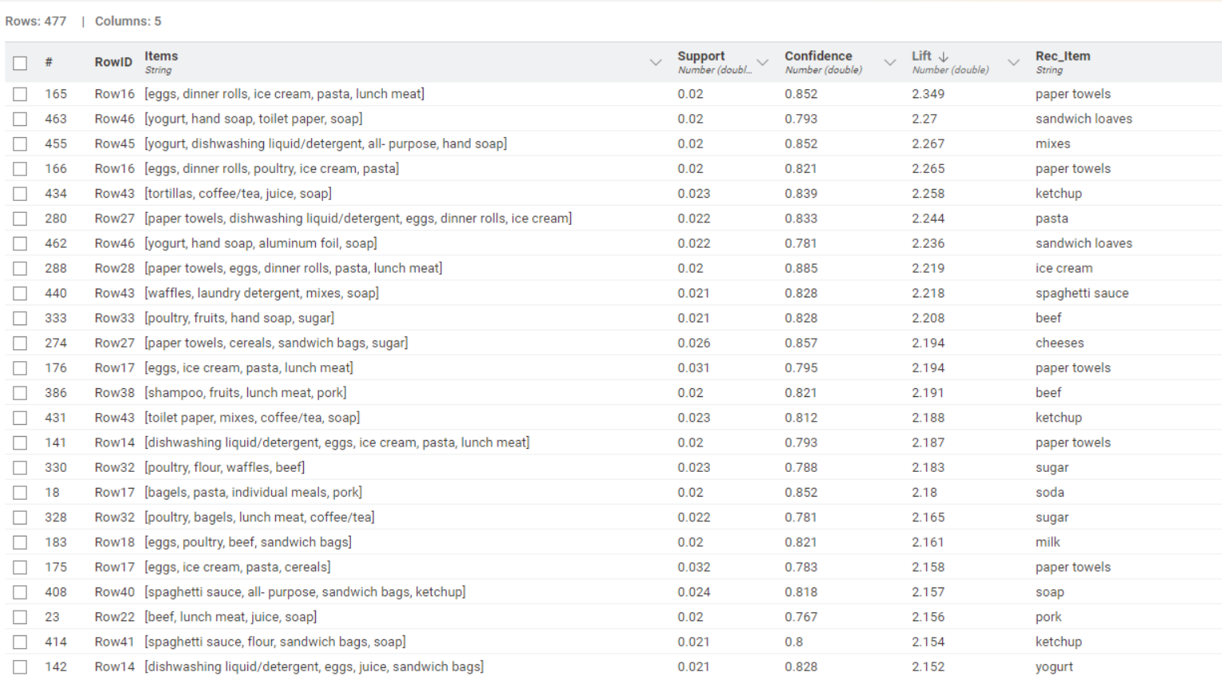
Products with recommendations

Slide 20
Understanding the illustration
The Previous Chart has been taken from Knime workflow which basically showcases the output of the analysis with a recommended item statistically the most preferred item if the customer has decided to buy the certain bundle of products. For ex customers who have bought eggs, dinner rolls, ice cream, pasta, lunch meat have been recommended Paper towels. This recommendations are not based entirely on behavior but this is the point where we can statistically determine the likelihood of a customer’s like after the customer has already finished his predetermined set of purchase as was felt necessary by himself.
The algorithm supersedes the customers planned purchase with a preplanned recommendation(s) which statistically has the highest probability of acceptance. This will help the retailer upsell and cross sell.
.

Slide 21
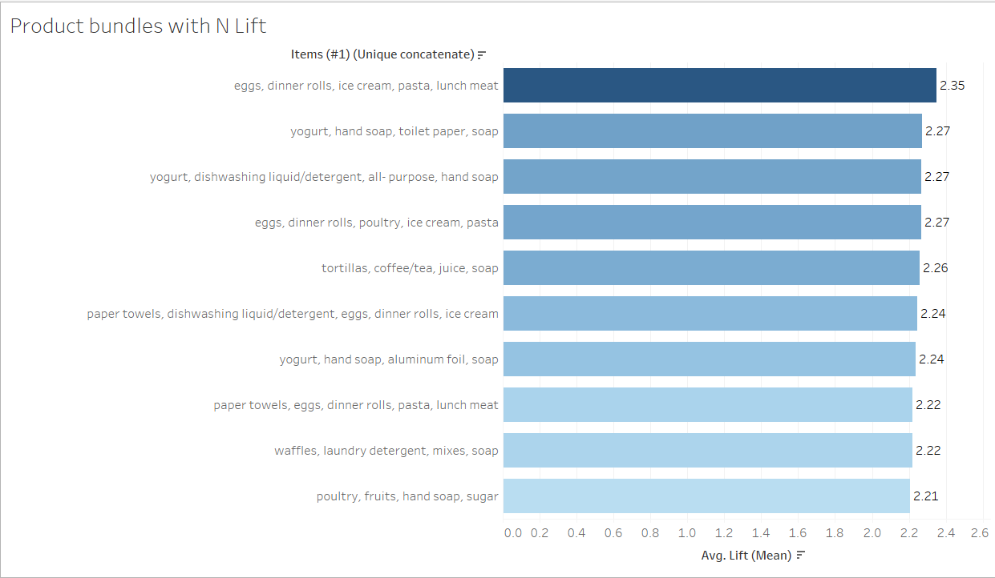
Top N Product bundles
The Item on the first column represents the Highest lift which means that customers are significantly more likely to buy these items in groups than buying them separately. These items by default have a confidence parameter exceeding 0.75 or 75% meaning we are highly confident of the likeability or likelihood of co-purchase increasing the bundle effectiveness. Sourced from Tableau.

Slide 22
Products with recommendations
Items | Support | Confidence | Lift | Rec_Item
eggs, dinner rolls, ice cream, pasta, lunch meat | 0.020193152 | 0.851851852 | 2.349296027 | paper towels
yogurt, hand soap, toilet paper, soap | 0.020193152 | 0.793103448 | 2.269710622 | sandwich loaves
yogurt, dishwashing liquid/detergent, all- purpose, hand soap | 0.020193152 | 0.851851852 | 2.266960886 | mixes
eggs, dinner rolls, poultry, ice cream, pasta | 0.020193152 | 0.821428571 | 2.265392598 | paper towels
tortillas, coffee/tea, juice, soap | 0.022827041 | 0.838709677 | 2.258369557 | ketchup
paper towels, dishwashing liquid/detergent, eggs, dinner rolls, ice cream | 0.021949078 | 0.833333333 | 2.243892829 | pasta
yogurt, hand soap, aluminium foil, soap | 0.021949078 | 0.78125 | 2.235788317 | sandwich loaves
paper towels, eggs, dinner rolls, pasta, lunch meat | 0.020193152 | 0.884615385 | 2.21933243 | ice cream
waffles, laundry detergent, mixes, soap | 0.021071115 | 0.827586207 | 2.217931034 | spaghetti sauce
poultry, fruits, hand soap, sugar | 0.021071115 | 0.827586207 | 2.207542599 | beef

Slide 23
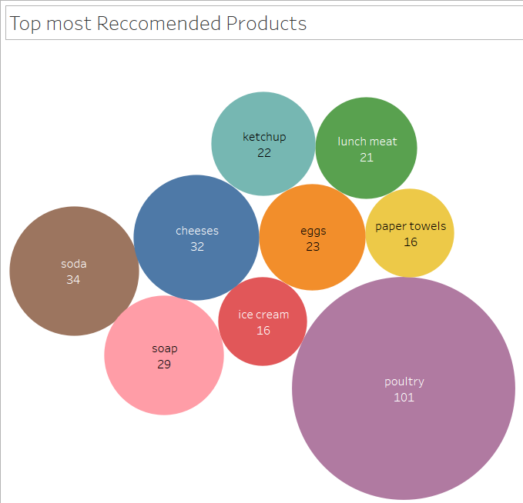
Top 9 products for rec’n
The adjacent plot illustrates the most recommended item as per the algorithm where Poultry seems to top the chart receiving the greatest number of recommendations. These are basically the items which are the most popular addons as per the statistical understanding and have been bought frequently in association with a variety of items. This indicates that these are the best of recommendations for bundle offers which the customers are most likely to accept.

Slide 24

Summary
In the months of low sales turnout March- June we can have bundle offers on products with high confidence with customers recommended with those products which have the highest recommendation frequency, In the months of High sales October –February we can push products with medium to low recommendation frequency.
We can have discounts on high volume purchase of items with higher confidence on Monday and Tuesday.
Products with low lift can be bundled with products with high lift as an addon with a reduced price point of the addon.

Slide 25

Thank you
Kunal sarkar 9903779913
iamkunalsarkar@live.com

